Slide 1


The Tech-Homebuilder
Increasing housing affordability by physical AI
Manuel Velasquez
Founder & CEO
Manuel@robuildx.co
www.robuildx.co

Slide 2

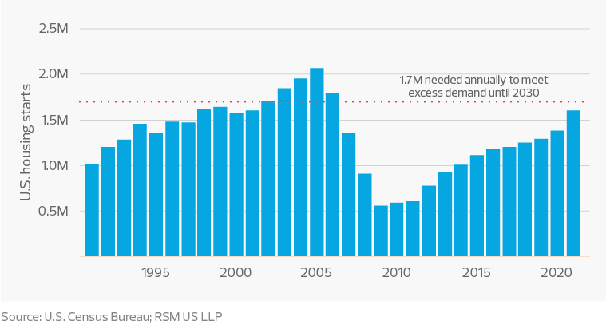

Housing affordability crisis for first time buyers
U.S. Housing Deficit
Limited purchasing power: Many families are unable to afford current housing prices
Inadequate living conditions: Households often occupy spaces smaller than what they truly need
Lack of wealth-building opportunities: Renting prevents families from building equity through homeownership
Housing uncertainty: Families face instability, unsure of where they’ll live in the coming year
Source: U.S. Census Bureau; RSM US LLP
Market Size: $14T

Slide 3
Homebuilding Automation
Price reduction, RoBX has 20% less production cost translating that to the price (5% -10%)
Doubling the speed, RoBX reduces the leasing amounts for households and doble profits for developers
Stability, Ownership & Wealth creation, RoBX open the market for more families moving them from leasing to ownership
Market Size: $14T

Slide 4
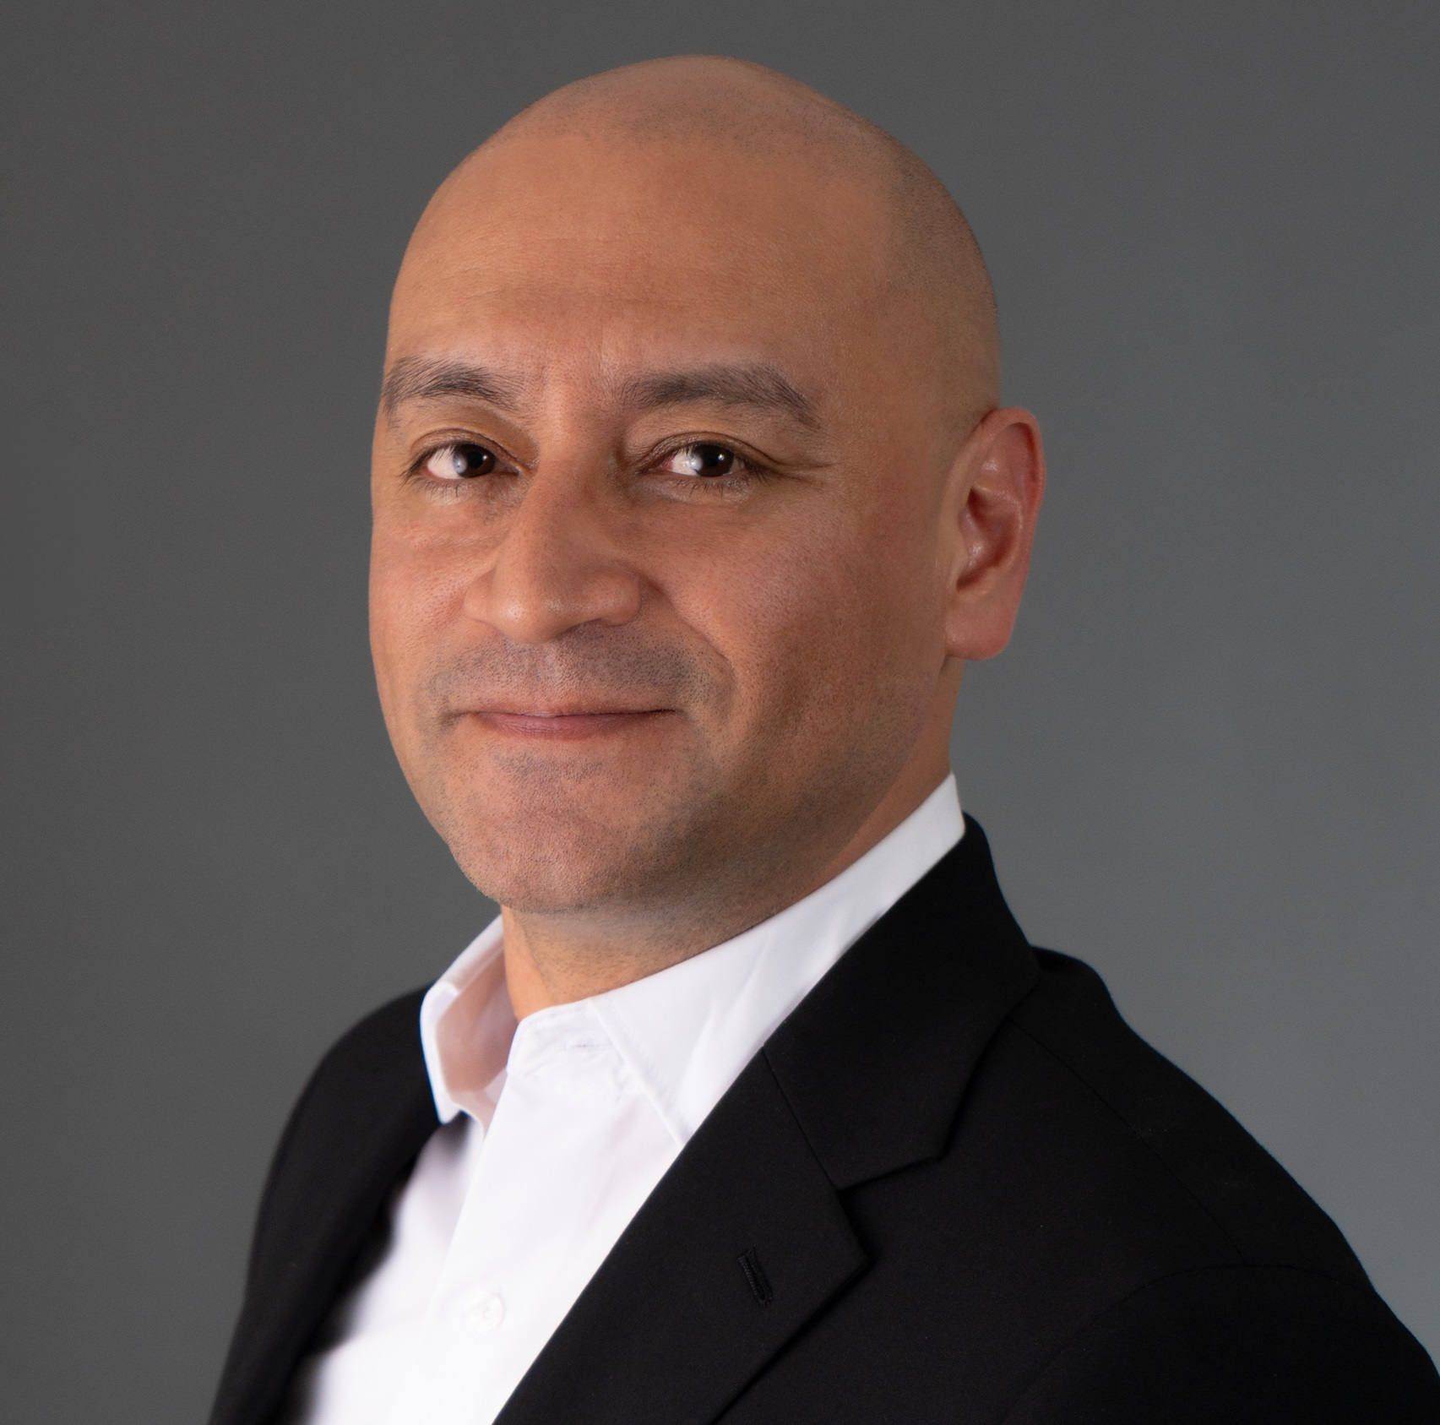



The RoBX Management Team
We are multidisciplinary innovators at the crossroads of homebuilding aggregating 100+ of experience
MIT grad with 20+ years of experience in construction, development, and real estate investments. Lead inventor of “The Movable Factory Theory” (5 patents)
Led projects encompassing a wide range of housing typologies amounting more 10,000 units across various stages of the real estate investment
MBA. Eng. Manuel
Velasquez
Founder & CEO
Homebuilding Expert
Technology leader with 20+ years of experience driving innovation in robotics, automation, and mechatronics
Inventor of 10 patents in robotic gripping and automation systems. Director of Hardware Engineering at Joint Space Automation Laboratories
MS. Eng. Jason Yap
CTO – Robotics Expert
Holds 20+ years of expertise in Real Estate Development and Construction
Led construction teams in remarkable international companies such as Turner Construction, Irvine Company and Lendlease
Eng. Kamran
Chaudhry
CCO – Construction Expert
Holds 20+ years of experience at homebuilding, has held senior roles at The New Home Company, Williams Homes, and Storm Properties
Sourced and executed over 4,000 residential lots and securing more than $2 billion in combined debt and equity financing
MS. Andrew Shapiro
Head of Investments
We are supported by 40+ multidisciplinary independent contractors

Slide 5

Market Size Worldwide
Retail
Partnering
Licensing
Development
Source: McKinsey Global Institute, 2025

Slide 6
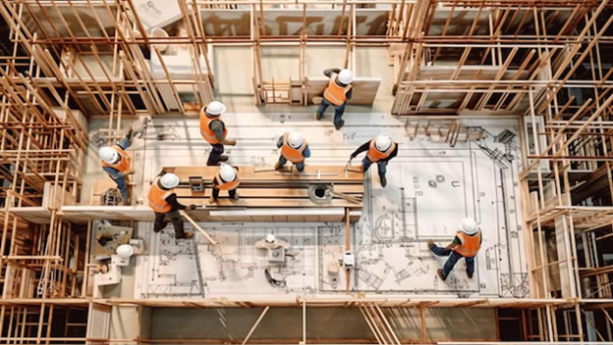

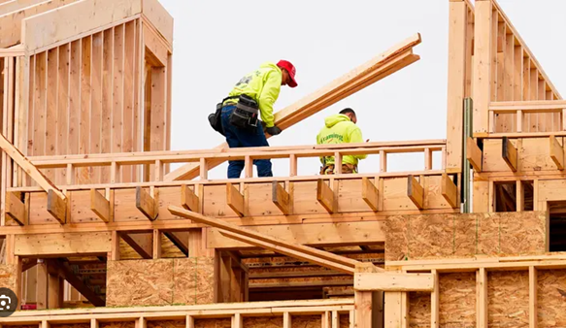
The Technology

Slide 7
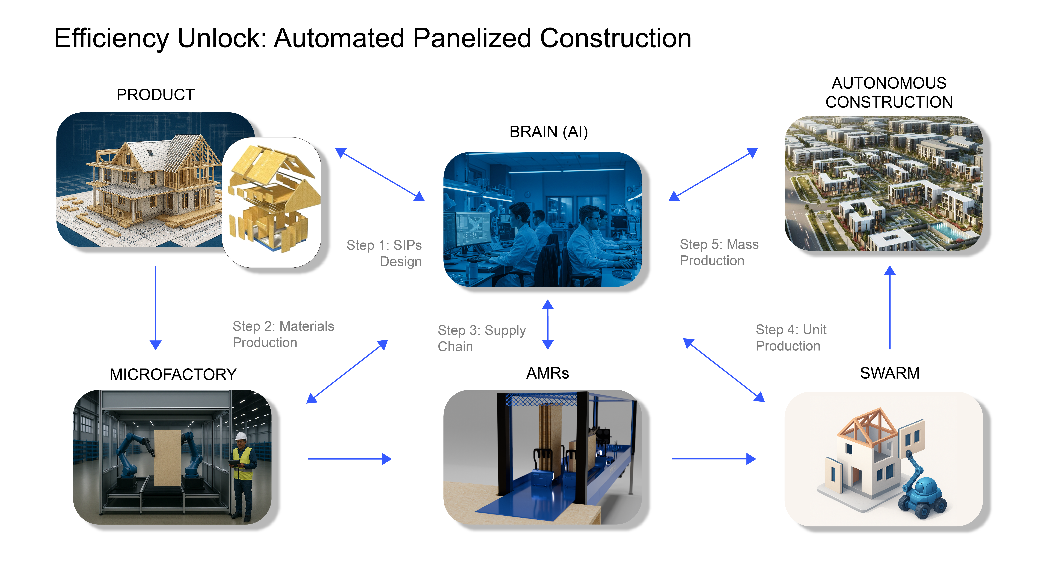
The RoBX Homebuilding System
Builds houses on-site at automated way
Deliver housing units faster, cheaper, and error-free
Best featured product (energy efficiency and asset value)

Slide 8
Product Roadmap
IP process started (5)
System Integration
Field Performance
Prototyping
Swarm Robotics
MVP
Model House
Design
Continuous
Improvement
02/25
06/25
10/25
02/26
04/26
08/26
Development
Manufacturing
Towards Next Generation

Slide 9
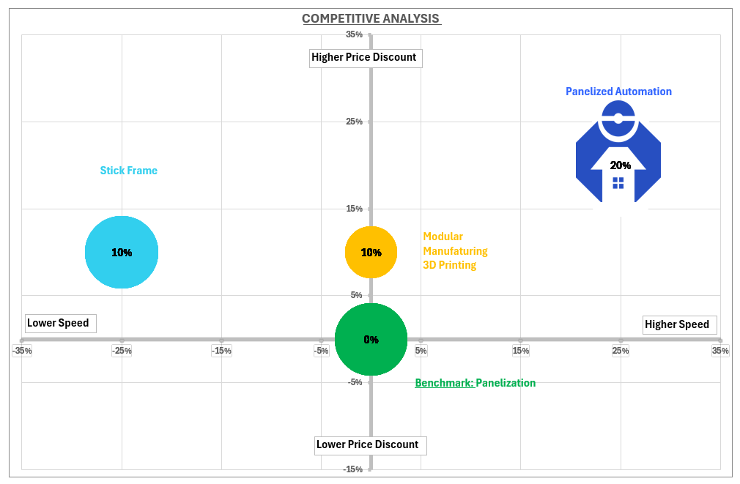
RoBX Competitive Advantage
More advantages:
Value Preservation (100%)
Lower Price (20%)
Energy efficiency (50%)
Sustainable & Subsidies
Source: RoBX Inc.

Slide 10
Go-To-Market Strategy
Partnering
Manufacturers and designers
Market Adoption
Retail Introduction
Licensing
Own Home Developments
10/25
01/26
04/26
08/26
03/27
10/27
10/28
Go-to-market
Marketing
First client
NEO Capital
Partnering
Developers & GCs

Slide 11
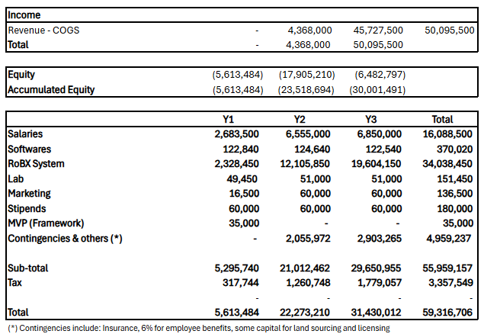
Financials
Breakeven point: Y3

Slide 12

Investors@robuildx.co
www.robuildx.co

